Slide 1

From Customer Life Events to organisational uplift.
Raising the value of strategic business architecture through deep integration with customer insights.
Chris Malcher, May 2025

Slide 2










Customer perspective
Skilled Migrant Journey
Discover and Research
Nominate
Submit application
Move to Australia
Settle
Live in Australia
Decide to stay

Slide 3





Customer perspective
Skilled Migrant Journey
Discover and Research
Nominate
Submit application
Move to Australia
Settle
Live in Australia
Decide to stay
Agency perspective
Inform and educate
Receive nomination
Process visa application
Support entry to Australia
Application
Deliver services
Process visa application
This method of value stream development combines very different types of expertise to create deep and well-targeted insights.
People Specialists
System Specialists

Slide 4
Skilled Migrant Journey – Connecting to “Apply for Service”
Discover and Research
Nominate
Submit application
Move to Australia
Settle
Live in Australia
Decide to stay
Research
Identify
Submit application
Wait / respond
Receive result and commence

Slide 5
Skilled Migrant Journey
Connecting to “Apply for Service”
Discover and Research
Nominate
Submit application
Move to Australia
Settle
Live in Australia
Decide to stay
Inform and educate
Receive nomination
Process visa application
Support entry to Australia
Application
Deliver services
Process visa application
Research
Identify
Submit application
Wait / respond
Receive result and commence
Inform and educate
Identify
Receive application
Assess and decide
Notify and commence

Slide 6
A common value stream
Apply for Service (/ Product)
Research
Identify
Submit application
Wait / respond
Receive result and commence
Inform and educate
Identify
Receive application
Assess and decide
Notify and commence

Slide 7
Identification of capabilities
Customer perspective
Research
Identify
Submit application
Wait / respond
Receive result and commence
Agency perspective
Inform and educate
Identify
Receive application
Assess and decide
Notify and commence
Business Capability
Business Capability
Business Capability
Business Capability
Business Capability

Slide 8
Identification of capabilities
Customer perspective
Research
Identify
Submit application
Wait / respond
Receive result and commence
Agency perspective
Inform and educate
Identify
Receive application
Assess and decide
Notify and commence
Business Capability
Business Capability
Business Capability
Business Capability
Business Capability
Identity Management

Slide 9
Identification of capability affecting customer pain point
Customer perspective
Research
Identify
Submit application
Wait / respond
Receive result and commence
Agency perspective
Inform and educate
Identify
Receive application
Assess and decide
Notify and commence
Business Capability
Business Capability
Business Capability
Business Capability
Business Capability
Identity Management

Slide 10
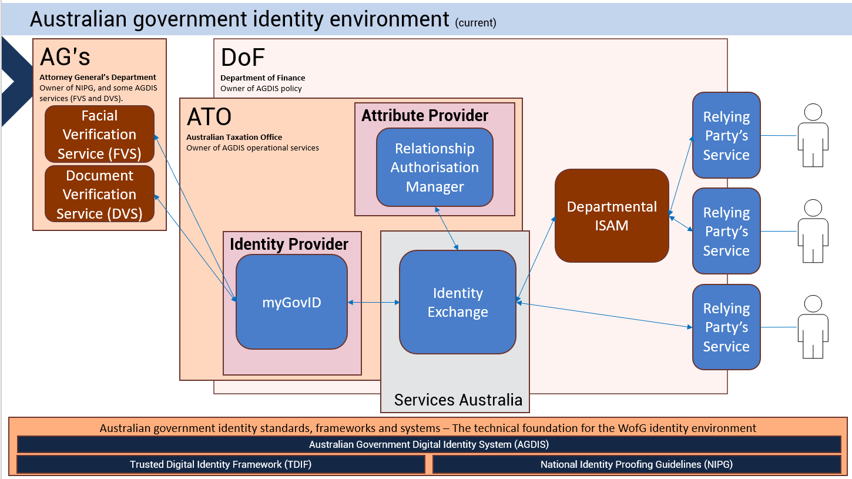
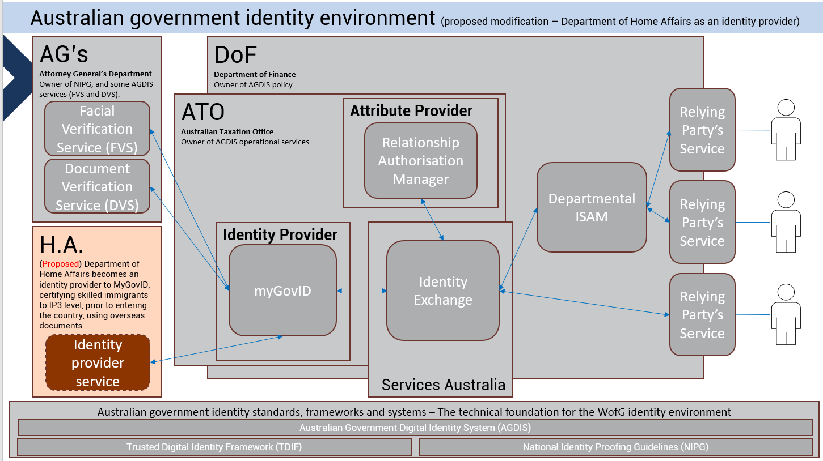
Defining the problem
Identification of capability requiring uplift
Customer perspective
Research
Identify
Submit application
Wait / respond
Receive result and commence
Agency perspective
Inform and educate
Identify
Receive application
Assess and decide
Notify and commence
Business Capability
Business Capability
Business Capability
Business Capability
Business Capability
Identity Management

Slide 11
Connecting from customer pain point to value stream stage to business capability needing uplift
Customer perspective
A customer pain point is identified, and is used as a key input to value stream analysis.
Research
Identify
Submit application
Wait / respond
Receive result and commence
Analysis of the business capability is conducted in the context of the value stream stage. Customer insights for that value stream stage are a critical input to analysis of applicable business capabilities.
Agency perspective
Inform and educate
Identify
Receive application
Assess and decide
Notify and commence
Business Capability
Business Capability
Business Capability
Business Capability
Business Capability
Identity Management

Slide 12
Connecting from customer pain point to value stream stage to business capability needing uplift
Recommended new initiative –
Cross-agency identity management
Customer perspective
Research
Identify
Submit application
Wait / respond
Receive result and commence
Agency perspective
Inform and educate
Identify
Receive application
Assess and decide
Notify and commence
Business Capability
Business Capability
Business Capability
Business Capability
Business Capability
Identity Management

Slide 13
A recommended solution to the problem
Recommended new initiative –
Cross-agency identity management
Customer perspective
Research
Identify
Submit application
Wait / respond
Receive result and commence
Agency perspective
Inform and educate
Identify
Receive application
Assess and decide
Notify and commence
Business Capability
Business Capability
Business Capability
Business Capability
Business Capability
Identity Management

Slide 14
These disciplines and analysis areas combine to deliver a core area of organisational value from strategic business architecture
6) … and described an initiative that could achieve that solution
1) An important customer pain point was identified
Recommended new initiative –
Cross-agency identity management
4) The gap between current and future state (delta) was defined
5) … a solution was identified
2) The key business capabilities that relate to the pain point were identified
3) Business architecture analysis identified where the problem stems from
Identity Management

