Slide 1
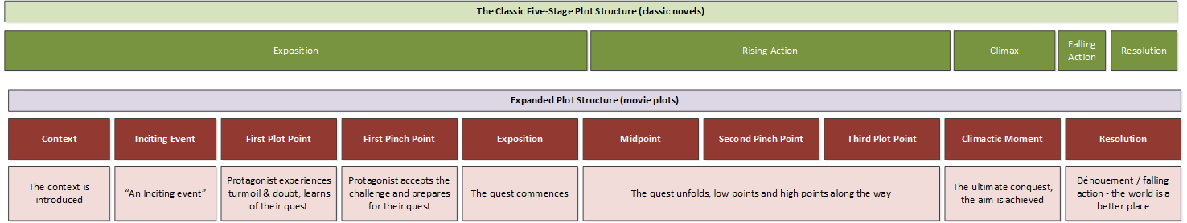
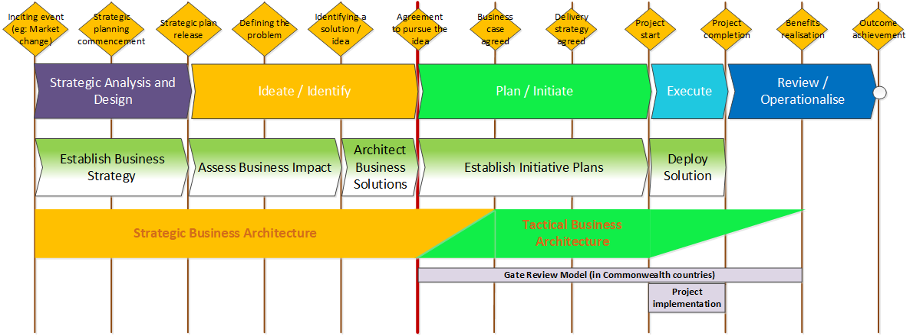
Business architecture across the initiative lifecycle
Feb 2023
This slide deck outlines a proposed concept of what business architecture is. It has potential implications for how the discipline is practiced and described, and may even have significant implications for how business architecture is utilised (and valued) in organisations.
Chris Malcher, Feb 2023, with contributions from Lorraine Pestell.
Slide deck available at; http://www.malcher.co/p-f/business-architecture.

Slide 2
Stories often follow a repeatable, traceable structure

Slide 3
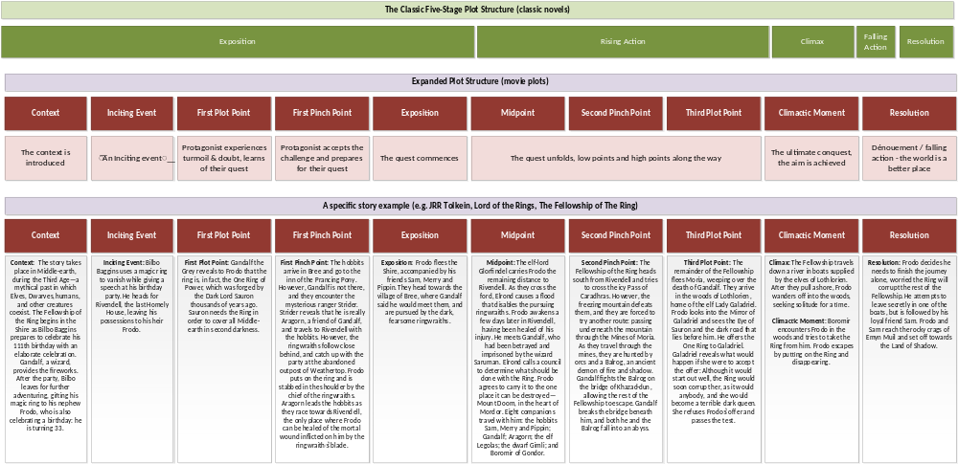
The structure is followed by even the most popular stories

Slide 4
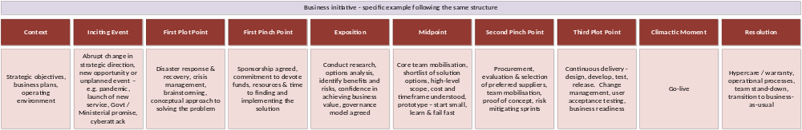
Business initiatives also usually follow a repeatable, traceable structure

Slide 5
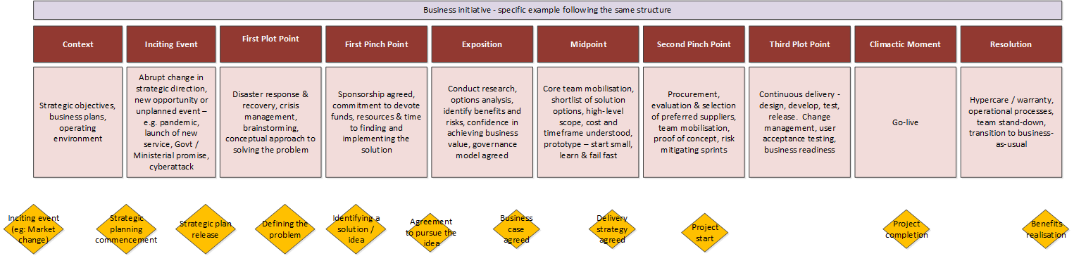
This repeatable structure usually has recognisable phases

Slide 6
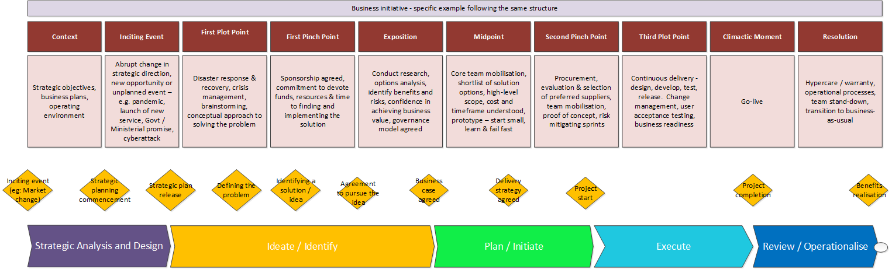
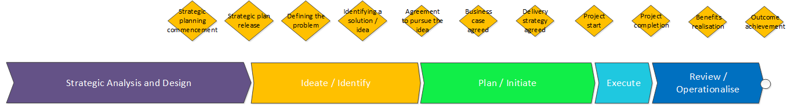
Key points in this lifecycle can be shown as milestones

Slide 7
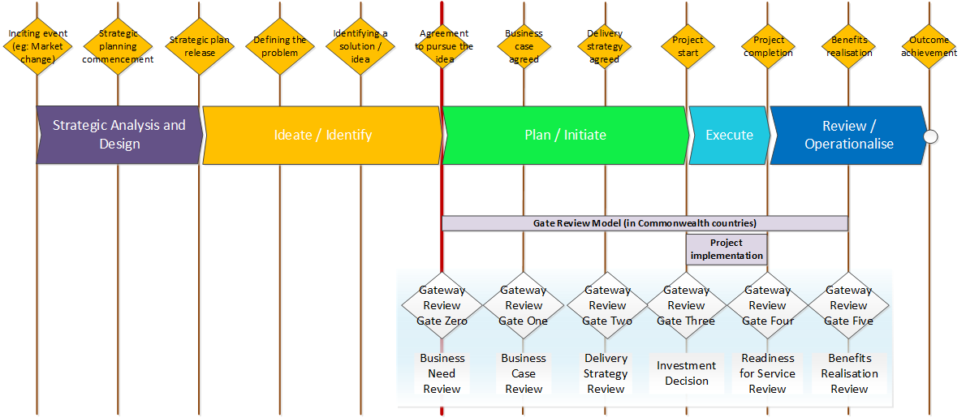
These milestones can be aligned to international models
(in this case – a model used in government agencies in Commonwealth countries)

Slide 8
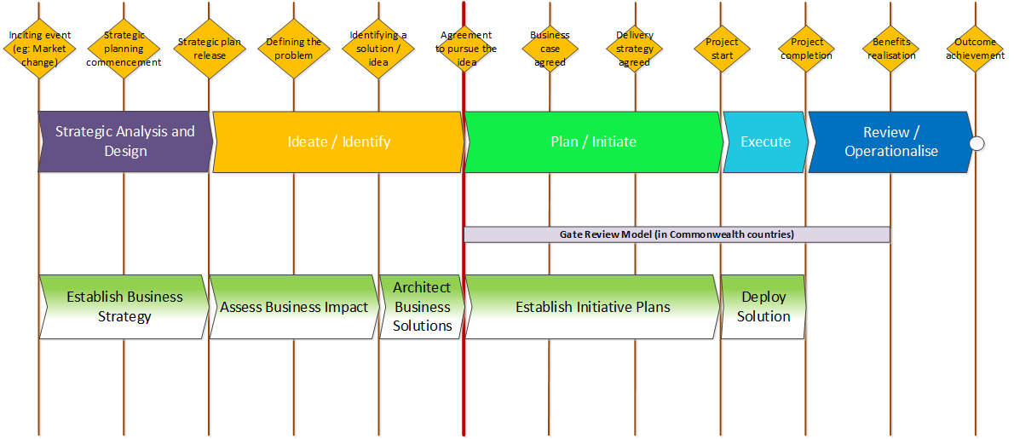
The BizBoK view of the initiative lifecycle can be aligned to these milestone points

Slide 9
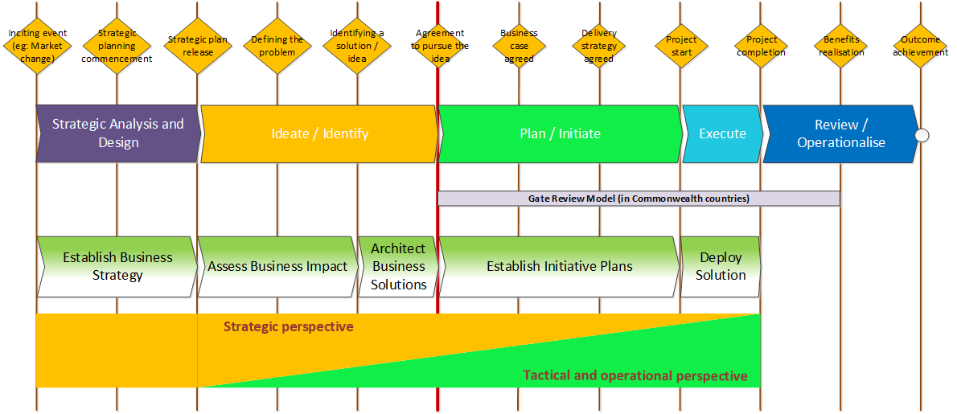
The degree to which we think in a strategic or tactical perspective can vary across the lifecycle

Slide 10
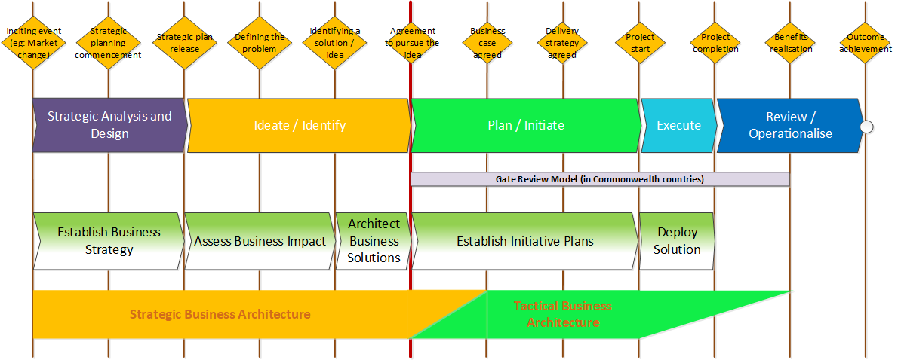
The perspectives we use in business architecture can also change across the lifecycle

Slide 11
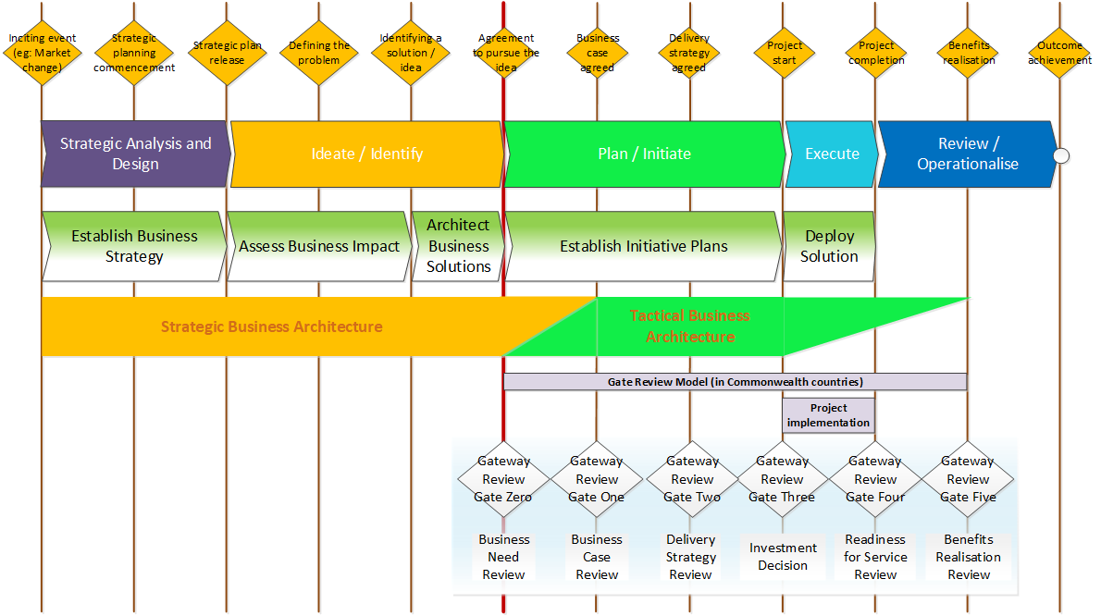
Having industry standard views of points on the initiative lifecycle, mapped across models, can help us to consistently define the different value of business architecture across the lifecycle.

Slide 12
This leads to three questions
How does business architecture, and its value, change across the initiative lifecycle?
Do we need a consistent lifecycle model to help us anchor lifecycle conversations?
What international lifecycle model can/should we use?

Slide 13
Questions for consideration;
How does business architecture, and its value, change across the initiative lifecycle?
On lifecycle models;
  Do we need a consistent lifecycle model to help us anchor lifecycle conversations?
  What international lifecycle model can/should we use?
On types of business architecture
  What is your view of the idea that there are two types of business architecture, with two different value propositions, practice a different stages in the initiative lifecycle?
  What impact would/should such a separation of types of business architecture have on how we design and describe our discipline?
  What impact could such a separation of types of business architecture have on our ability to “sell” the discipline within our organisations?
Notes
Please feel free to test and use these concepts in your own environments. I’ll be happy to share the source Visio files for the diagrams.
If you aim to use and improve these concepts and representations – please remember to share your improvements. The concepts, and their representation, is a work in progress created from a very particular perspective. Input / correction / refinement from different perspectives is very welcome. The work can be regarded as “Creative Commons – Share Alike” – feel free to use and improve, with appropriate attribution, and remember to share what you’ve improved.

